Slide 1

Fiscal Services
2015 - 2016
New Administrator Workshop

Slide 2

Payroll
Budget
Expenditures
Cash
ASB
Attendance

Slide 3

Business Operating Systems
Financial 2000
  Budget Transfers
  Accounts Lookup
  EduReports
BEST NET (Employee Self-Service System)
ELTS (Electronic Leave Tracking System)
Smarte (PSRs)

Slide 4


Slide 5

What to look for when signing a timecard.
TIMECARDS
From and To time = number of hours worked
Mgmt 5000 = name of absent employee/vacancy
Mgmt XXXX (school site) = PSR number
Be sure to sign each line or that your signature is on a diagonal line that touches all entries that you are approving.
Remember:
Your signature is approving that the employee has authorization to work for the number of hours listed on his/her timecard.

Slide 6
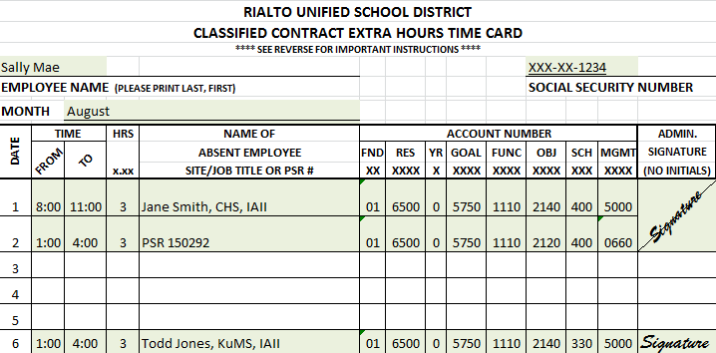

Slide 7
What to look for when signing an affidavit.
ELTS
Employee Leave Tracking System
The bank the leave is being charged to
The employee’s bank balances

Slide 8
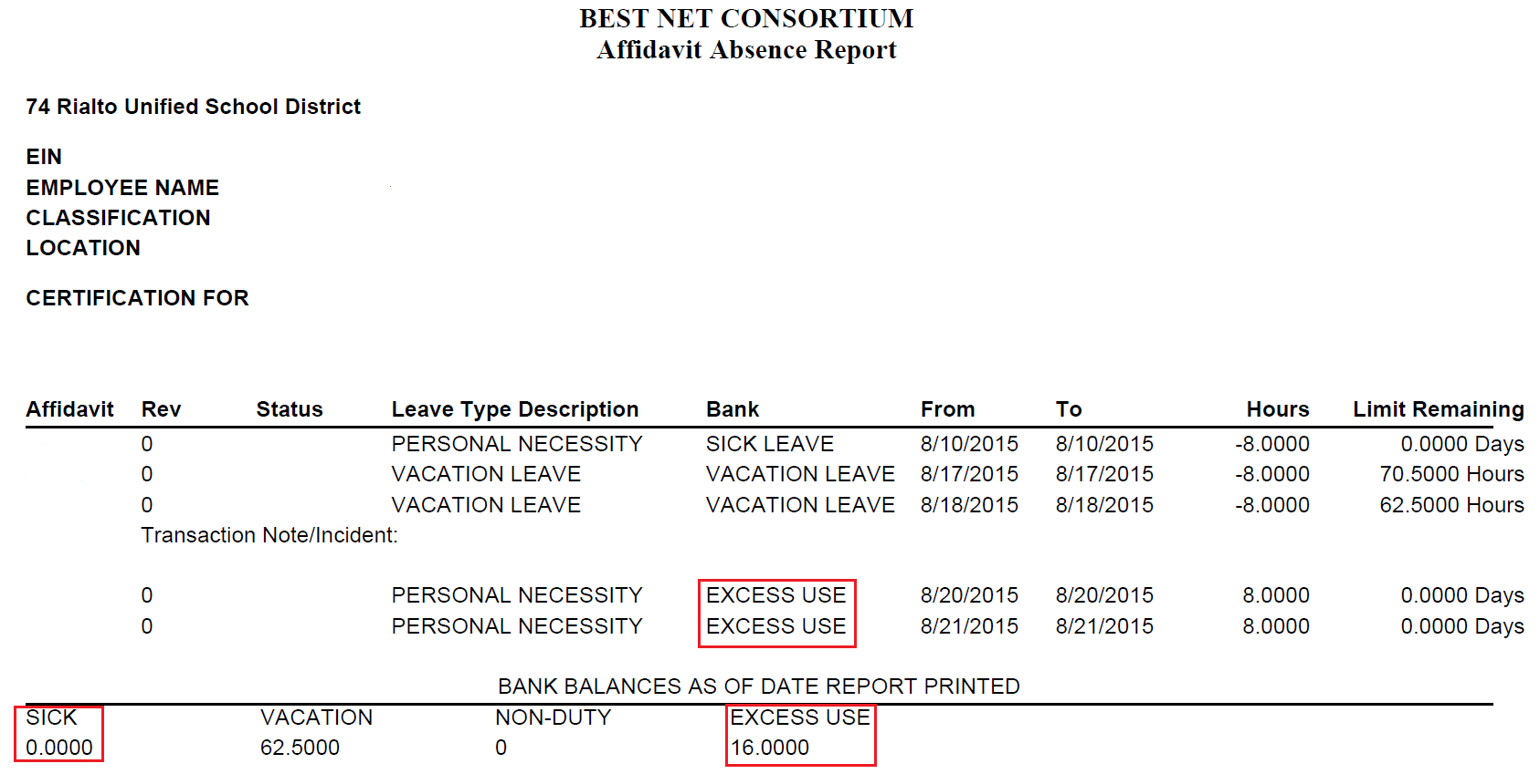

Slide 9
What’s the big fuss about AFFIDAVITS?
When is an affidavit required?
Whenever an employee is absent from work other than for school business or on an approved leave of absence.
How often should affidavits be sent up to Payroll?
Weekly

Slide 10

If an employee needs to change an affidavit that has
already been submitted to Payroll, what should the
employee do?
  Obtain a copy of his/her original affidavit
  Make changes as needed
  Write “Revised” on the top of the affidavit
  Submit to his/her administrator for approval
  Forward to Payroll for change(s) to be made
Will Payroll accept an affidavit without an employee’s signature?
  Yes, when the dates are covered by an acceptable doctor’s off work order (including Industrial Injury) and when an employee has been absent for an extended period. “Signature Unavailable” must be written on the “Signature of Employee” line.

Slide 11
Why is it important for the employee and the administrator to date their affidavit when signing it?
Dating the affidavit provides important back up documentation for the employee, the administrator,
and the site when issues occur.
What happens when affidavits are not sent to Payroll in a timely manner?
    Employee complaints
    Overpayment

Slide 12
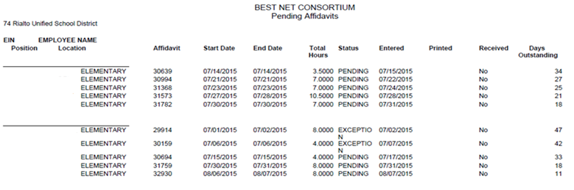
Employee Monthly Report
Attach all affidavits listed on your report, sign and submit to Fiscal Services by the 15th of each month.

Slide 13
PERSONNEL SERVICES REQUEST (PSR)
What is the purpose of a PSR and when should one be completed?
A PSR is the official way for you to request approval for staffing changes at your site.
A PSR allows for proper budget alignment of your staffing expenses.
A PSR is required for both temporary changes (extra hours, substitutes) and long-term changes, such as an increase or decrease in staffing needs.

Slide 14
PSR – REQUEST FOR POSITION
When does a REQUEST FOR POSITION PSR need to be completed?
Anytime there is any change
to a position at your site...
A new position is being requested
A vacant position needs to be filled
Hours increase for a position
Hours decrease for a position
A position is eliminated
Position funding changes

Slide 15
PSR - OTHER
Used for:
Certificated Extra-Duty
Certificated Substitute
Classified Extra Hours
Classified Substitute
Other

Slide 16

Local Control Funding Formula (LCFF)
Replaces the Revenue Limit funding model
Emphasis on local decision making and stakeholder involvement
Additional resources for economically disadvantaged, English learners, and foster youth students
Increased accountability, transparency, and alignment of budget with local plan
Eight years for full implementation
Requires Local Control Accountability Plan
(LCAP)

Slide 17
How do I Impact LCAP & the LCFF
Your students’ needs drive the LCAP
Alignment of school site plans to LCAP
Your students’ economic condition affect our funding
  Free & Reduced Lunch Applications
Your students’ EL or Foster Youth designation generates additional funding
  Synergy data

Slide 18

Budget
Site Discretionary – aka Resource 0011
Based on CBEDS enrollment from prior year, includes regular and special education
Budget expenses where they will be spent
Use EduReports to review history
Plan future purchases
Cover negatives
Do not move budget between different funding sources (ex. Site discretionary to Step Up)

Slide 19

Commonly Misunderstood Fiscal Policies
Student Rewards
Adult Rewards
Food/Snacks
Travel & Conference

Slide 20
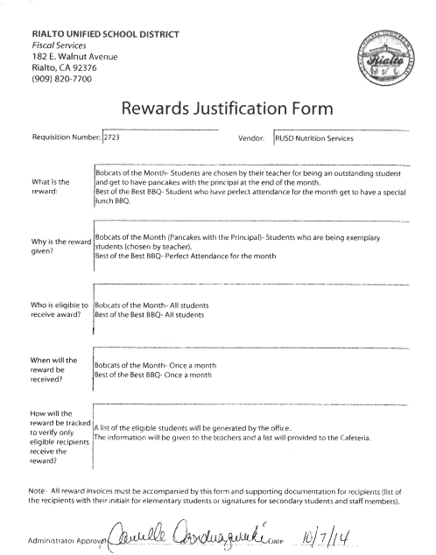

Slide 21
Expenditures
Review what you are signing. Is it compliant? Is it reasonable? Is it a direct benefit to the students?
If you don’t agree, VOID the requisition!
When out for extended time, turn on the work flow forwarding.
Allow two weeks for approval routing.
Once the invoice is received in Fiscal, it can take up to three weeks to clear audit at SBCSS District Financial Services and receive a check.
PLAN ACCORDINGLY!!

Slide 22

APPROVALS/SIGNATURES
Please remember that you are NOT allowed to approve your own personal expenses.
A supervisor’s signature MUST be obtained for:
  PSRs
  Timecards
  Travel Expense Reimbursements
  Other Employee Reimbursements

Slide 23

CASH
Ensure all cash is properly safeguarded.
Every principal should verify a safe is used and the combination is functional. Principals should restrict who has access to the
combination.
Elementary schools must take bank deposits to the bank.
Secondary schools have armored pick-up services.
Deposit should be made weekly or anytime the site holds more than $500.
BU-100 form must be completed weekly. As an, administrator you are signing this document to acknowledge the cash activities occurring at your site or the lack of cash collection for the week.

Slide 24
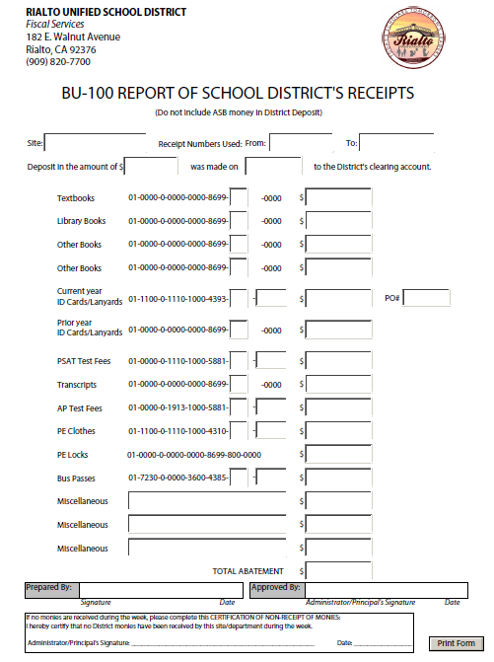

Slide 25
CASH
Monitor your site’s activities.
  2 people should be counting
  Admin should be counting before signing BU 100
If money is collected:
  Review receipts
  Review site deposits
  Review bank deposits
  Look at the dates
  Look in closets, drawers, filing cabinets, everywhere!
CASH IS RISKY… DO NOT HOLD IT AT YOUR SITE!

Slide 26
Purchasing Deadlines
Plan for your purchases
Purchasing deadline is typically at the end of March
Goods or Services MUST be delivered by June 30
Money received in the current year does not generally carryover to the new year (exceptions are Step-Up & Donations)
“THIS YEAR’S MONEY FOR THIS YEAR’S KIDS!”

Slide 27

ASB
ASB
Accountability
Activities Director, Club Sponsor, ASB Council,
ASB Finance Clerks
Review monthly statements and bank reconciliations
Adjustments/Journal Entries must have explanations and approval by the administrator in charge.
Site Audits

Slide 28

Attendance
Review monthly attendance reports.
Ensure staff is verifying absences.
Is your enrollment reasonable to the
bodies at your site?
Step-Up
Attendance rates

Slide 29

ANY QUESTIONS?

